Slide 1

Instagram Data Repository
GROUP-2
Team Members:
23VE1AO5G5 : M.SISIRA
23VE1AO5D2 : SAMPREETH
23VE1AO5J0 : PRAVEEN
23VE1AO5D6 : GANI
23VE1AO5D8 : MANI KUMAR
Notes:
23VE1AO5G5 : M.SISIRA
23VE1AO5D2 : SAMPREETH
23VE1AO5J0 : PRAVEEN
23VE1AO5D6 : GANI
23VE1AO5G5 : MANI KUMAR
GROUP-2
Team Members:

Slide 2
Instagram Data Repository
GROUP-2
Team Members:
23VE1AO5G5 : M.SISIRA
23VE1AO5D2 : SAMPREETH
23VE1AO5J0 : PRAVEEN
23VE1AO5D6 : GANI
23VE1AO5D8 : MANI KUMAR
Notes:
23VE1AO5G5 : M.SISIRA
23VE1AO5D2 : SAMPREETH
23VE1AO5J0 : PRAVEEN
23VE1AO5D6 : GANI
23VE1AO5G5 : MANI KUMAR
GROUP-2
Team Members:

Slide 3
Instagram Data Repository
GROUP-2
Team Members:
23VE1AO5G5 : M.SISIRA
23VE1AO5D2 : SAMPREETH
23VE1AO5J0 : PRAVEEN
23VE1AO5D6 : GANI
23VE1AO5D8 : MANI KUMAR
Notes:
23VE1AO5G5 : M.SISIRA
23VE1AO5D2 : SAMPREETH
23VE1AO5J0 : PRAVEEN
23VE1AO5D6 : GANI
23VE1AO5G5 : MANI KUMAR
GROUP-2
Team Members:

Slide 4

Agenda
01
Purpose and
overview of the data stored.
02
03
04
Description of data types(e.g. posts, comments, likes,followers
How to access, permissions, and privacy considerations
Guidelines for analysis and reporting
Notes:
Purpose and overview of the data stored.

Slide 5
Agenda
01
02
Purpose and
overview of the data stored.
Description of data types(e.g. posts, comments, likes,followers
03
04
How to access, permissions, and privacy considerations
Guidelines for analysis and reporting
Notes:
Purpose and overview of the data stored.

Slide 6
Agenda
01
02
03
Purpose and
overview of the data stored.
Description of data types(e.g. posts, comments, likes,followers
How to access, permissions, and privacy considerations
04
Guidelines for analysis and reporting
Notes:
Purpose and overview of the data stored.

Slide 7
Agenda
01
02
03
04
Purpose and
overview of the data stored.
Description of data types(e.g. posts, comments, likes,followers
How to access, permissions, and privacy considerations
Guidelines for analysis and reporting
Notes:
Purpose and overview of the data stored.

Slide 8
Abstract
The Instagram Data Repository is a structured storage system designed to
manage and maintain the vast amounts of data generated by users interacting
with the platform. This repository encompasses several core components that
support Instagram’s functionality, including user profiles, content creation, social
interactions, and messaging. This database model emphasizes scalability, data
integrity, and security, supporting a high-volume transactional system that can
expand as the user base grows. Built on a relational schema, it employs tables and
relationships to ensure data normalization and efficient querying.
The Instagram Data Repository is critical for providing a seamless and engaging
user experience, allowing users to connect, share, and interact within a dynamic
social media environment.
Notes:
The Instagram Data Repository is a structured storage system designed to
manage and maintain the vast amounts of data generated by users interacting
with the platform. This repository encompasses several core components that
support Instagram’s functionality, including user profiles, content creation, social
interactions, and messaging. This database model emphasizes scalability, data
integrity, and security, supporting a high-volume transactional system that can
expand as the user base grows. Built on a relational schema, it employs tables and
relationships to ensure data normalization and efficient querying.
The Instagram Data Repository is critical for providing a seamless and engaging
user experience, allowing users to connect, share, and interact within a dynamic
social media environment.

Slide 9

Entities:
Users
Post
Likes
Follows
Comments
Relationship:
User shares Post
Post Accumulates Likes
Post receive comment
User Manage Follows
Notes:
Relationship:
User shares Post
Post Accumulates Likes
Post receive comment
User Manage Follows

Slide 10
Cardinality:
One-to-Many Relationship between User and Post
One-to-Many Relationship between Post and Comment
One-to-Many Relationship between Post and Like
Many-to-Many Relationship between User and Follow
Notes:
Cardinality:

Slide 11
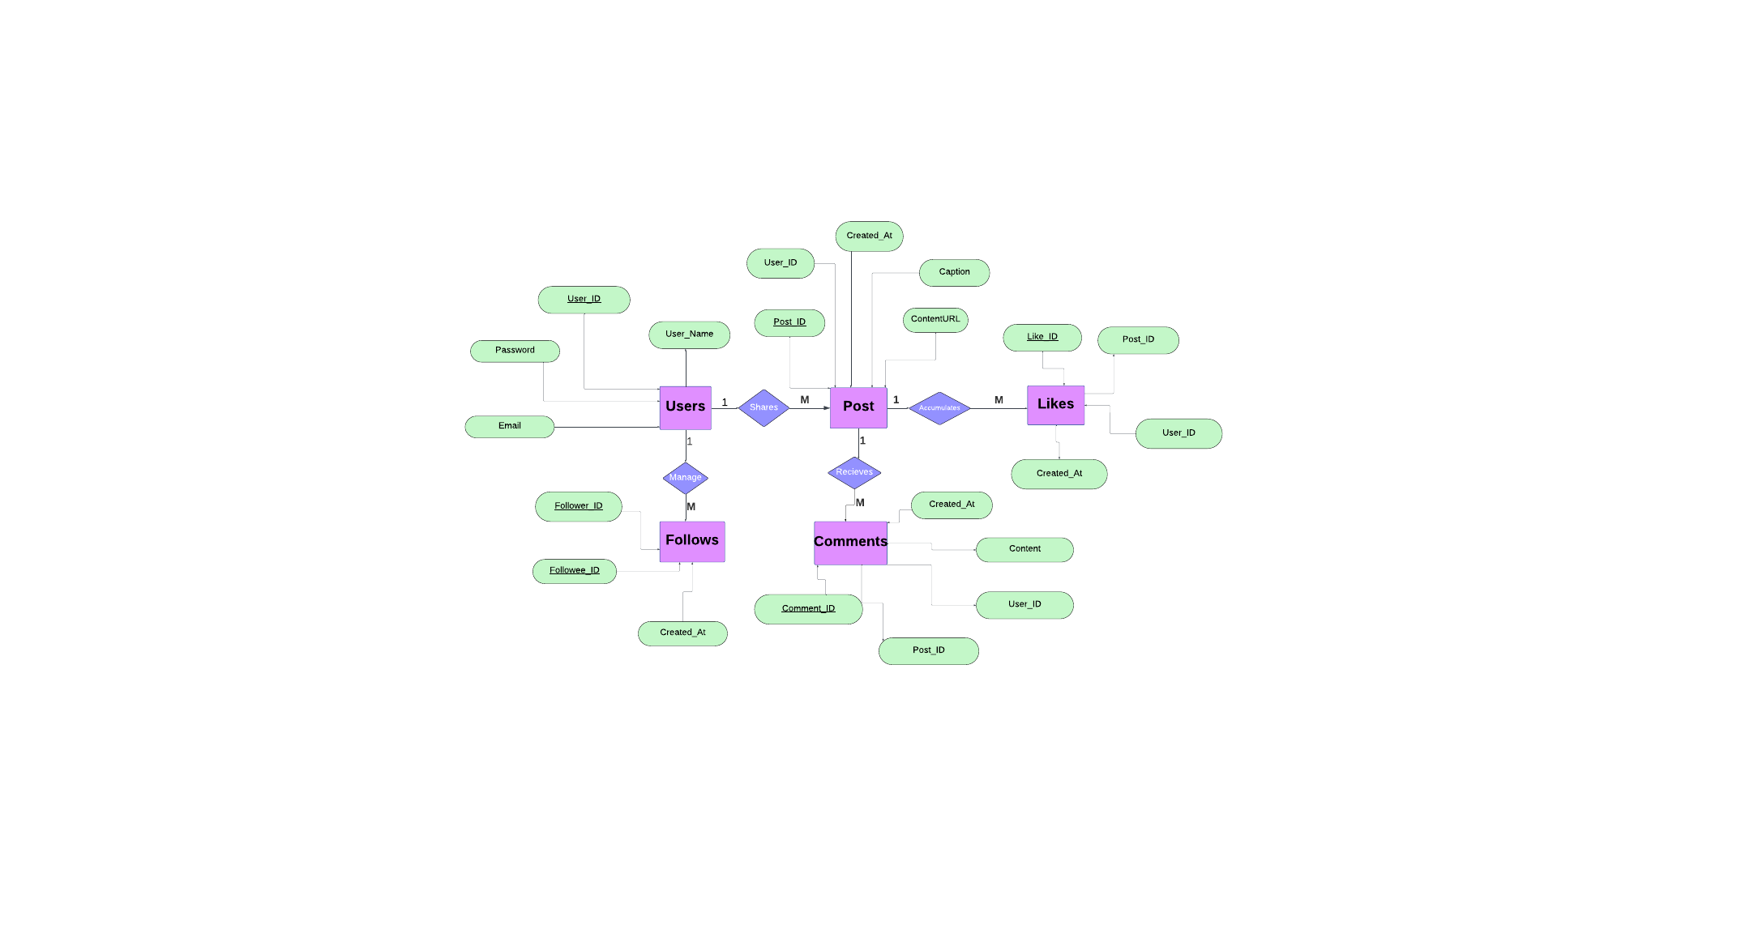
ER Diagram:
Notes:
ER Diagram:

Slide 12
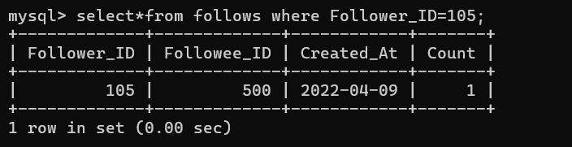
1. First Normal Form (1NF):
Each column must contain atomic (indivisible) values, and each record must be unique.
All columns in each table seem to contain atomic values (e.g., User_ID,Post_ID, content, etc.), which means there are no repeating groups or arrays.
Primary keys like comments_ID, Follower_ID, and Likes_ID provide uniqueness in their respective tables.
Conclusion: The tables satisfy 1NF.
Notes:
1. First Normal Form (1NF):
Each column must contain atomic (indivisible) values, and each record must be unique.
All columns in each table seem to contain atomic values (e.g., User_ID,Post_ID, content, etc.), which means there are no repeating groups or arrays.
Primary keys like comments_ID, Follower_ID, and Likes_ID provide uniqueness in their respective tables.
Conclusion: The tables satisfy 1NF.

Slide 13
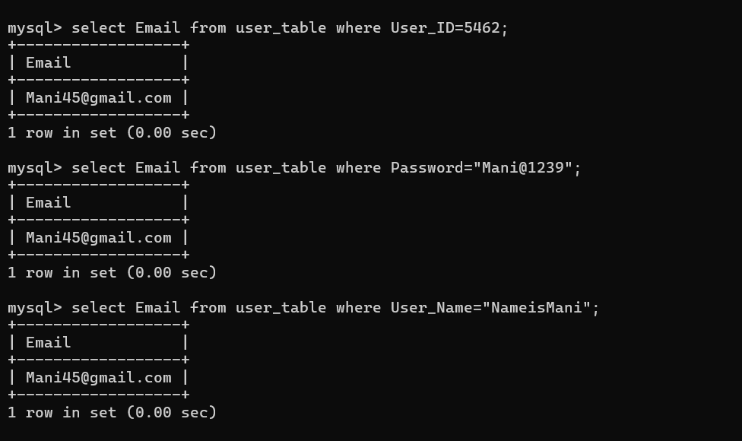
2. Second Normal Form (2NF):
The table must be in 1NF, and each non-key attribute must depend on the entire primary key (no partial dependency).
Each table has a primary key (single-column keys in User, Post_1, Follows, Likes, and comments tables), so partial dependency does not apply.
Conclusion: The tables satisfy 2NF.
Notes:
2. Second Normal Form (2NF):
The table must be in 1NF, and each non-key attribute must depend on the entire primary key (no partial dependency).
Each table has a primary key (single-column keys in User, Post_1, Follows, Likes, and comments tables), so partial dependency does not apply.
Conclusion: The tables satisfy 2NF.

Slide 14
3. Third Normal Form (3NF):
The table must be in 2NF, and there should be no transitive dependency (non-key attributes should not depend on other non-key attributes).
User Table: The User_Name, Password, and Email depend only on User_ID, which is the primary key.
Post_1 Table: Each attribute (User_ID, Created_At, Caption, ContentURL) depends directly on Post_ID.
comments Table: Each attribute (User_ID, Post_ID, content, Created_At) depends on comments_ID.
Follows Table: Followee_ID and Created_At depend directly on Follower_ID.
Likes Table: Each attribute depends directly on Likes_ID.
Conclusion: There are no transitive dependencies, so the tables satisfy 3NF.
Notes:
3. Third Normal Form (3NF):
The table must be in 2NF, and there should be no transitive dependency (non-key attributes should not depend on other non-key attributes).
User Table: The User_Name, Password, and Email depend only on User_ID, which is the primary key.
Post_1 Table: Each attribute (User_ID, Created_At, Caption, ContentURL) depends directly on Post_ID.
comments Table: Each attribute (User_ID, Post_ID, content, Created_At) depends on comments_ID.
Follows Table: Followee_ID and Created_At depend directly on Follower_ID.
Likes Table: Each attribute depends directly on Likes_ID.Likes Table: Each attribute depends directly on Likes_ID.
Conclusion: There are no transitive dependencies, so the tables satisfy 3NF.

Slide 15
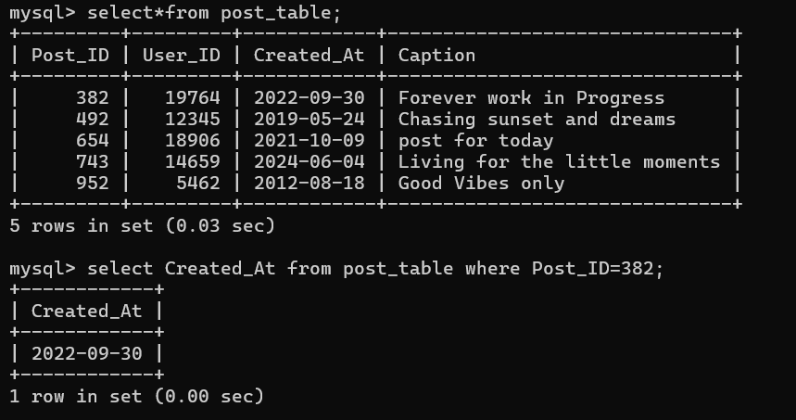
4. Boyce-Codd Normal Form (BCNF):
Every determinant must be a candidate key (a stricter form of 3NF).
All tables appear to have primary keys as unique identifiers without functional dependencies on non-key attributes.
Conclusion: The tables satisfy BCNF.
Notes:
4. Boyce-Codd Normal Form (BCNF):
Every determinant must be a candidate key (a stricter form of 3NF).
All tables appear to have primary keys as unique identifiers without functional dependencies on non-key attributes.
Conclusion: The tables satisfy BCNF.

Slide 16
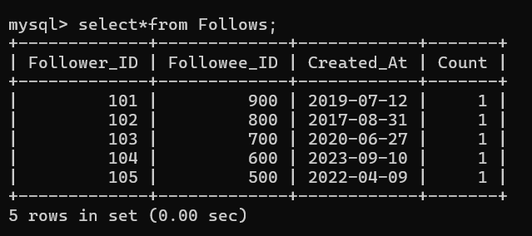
4. Fourth Normal Form (4NF):
A table must be in BCNF, and it should not have any multi-valued dependencies unless they are functionally dependent on a superkey.
Multi-valued Dependency: This occurs when one attribute in a table uniquely determines another attribute, independent of all other attributes. In other words, if there are multiple independent relationships in the same table, they should be separated.
In each table (User, Post_1, comments, Follows, and Likes), there don’t appear to be any multi-valued dependencies because each record maintains a single relationship between the attributes.
Conclusion: The tables satisfy
4NF because
there are no
multi-valued dependencies.
Notes:
Requirement: A table must be in BCNF, and it should not have any multi-valued dependencies unless they are functionally dependent on a superkey.
Multi-valued Dependency: This occurs when one attribute in a table uniquely determines another attribute, independent of all other attributes. In other words, if there are multiple independent relationships in the same table, they should be separated.
Analysis:
In each table (User, Post_1, comments, Follows, and Likes), there don’t appear to be any multi-valued dependencies because each record maintains a single relationship between the attributes.
For example, in the Follows table, each Follower_ID is related to a single Followee_ID per record, and no attribute has multiple independent relationships.
Conclusion: The tables satisfy 4NF because there are no multi-valued dependencies.

Slide 17
5. Fifth Normal Form (5NF) or Project-Join Normal Form (PJNF):
A table must be in 4NF, and it should not have any join dependencies that could cause data redundancy. 5NF decomposes tables further to eliminate redundancy due to join dependencies.
Join Dependency: This occurs when data in a table can be split into multiple tables without losing any information and without introducing redundancy. Essentially, if a table can be reconstructed by joining smaller tables without any loss of information, it should be decomposed.
The given tables represent simple, single-entity relationships (e.g., users, posts, comments, follows, likes) and don't show any complex relationships that would require decomposition to avoid redundancy.
There is no evidence of join dependencies that would require further decomposition in this database design
Notes:
5. Fifth Normal Form (5NF) or Project-Join Normal Form (PJNF):
Requirement: A table must be in 4NF, and it should not have any join dependencies that could cause data redundancy. 5NF decomposes tables further to eliminate redundancy due to join dependencies.
Join Dependency: This occurs when data in a table can be split into multiple tables without losing any information and without introducing redundancy. Essentially, if a table can be reconstructed by joining smaller tables without any loss of information, it should be decomposed.
Analysis:
The given tables represent simple, single-entity relationships (e.g., users, posts, comments, follows, likes) and don't show any complex relationships that would require decomposition to avoid redundancy.
There is no evidence of join dependencies that would require further decomposition in this database design.
Conclusion: The tables satisfy 5NF as there are no join dependencies requiring additional decomposition.

Slide 18
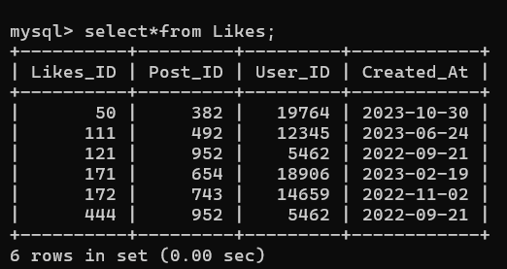
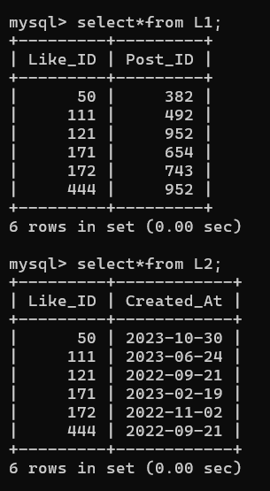
Decomposed into L1 and L2
Notes:
Original Table
Decomposed into L1 and L2

Slide 19
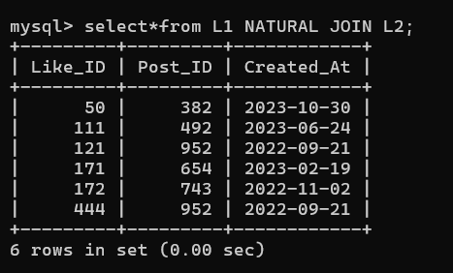
Joining L1 and L2
Conclusion: The tables satisfy 5NF as there are no join dependencies requiring additional decomposition.
Notes:
Joining L1 and L2

Slide 20
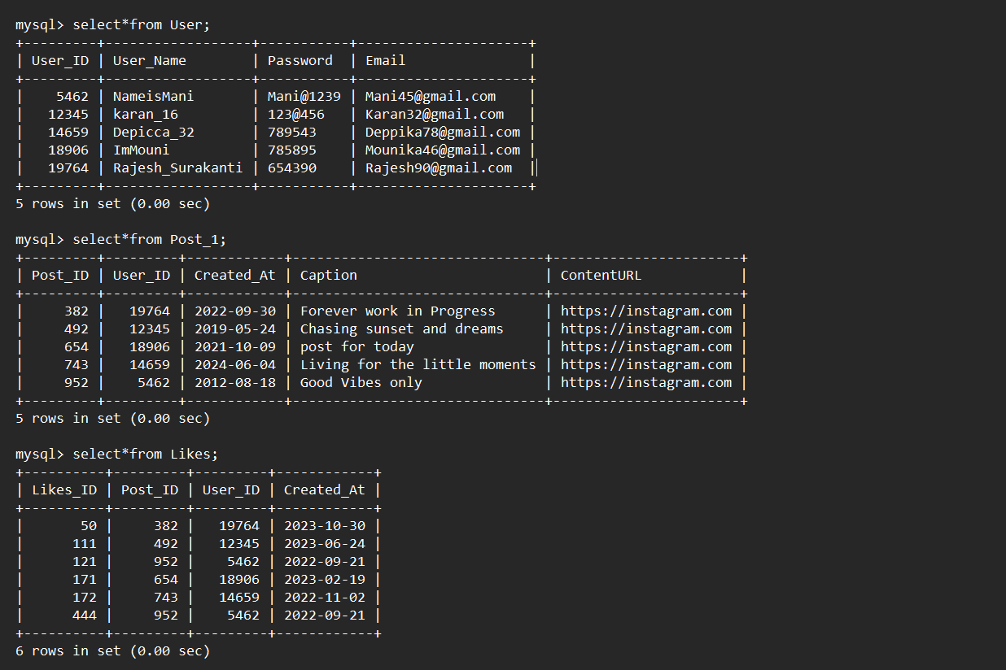
Relational Model
Notes:
Relational Model

Slide 21
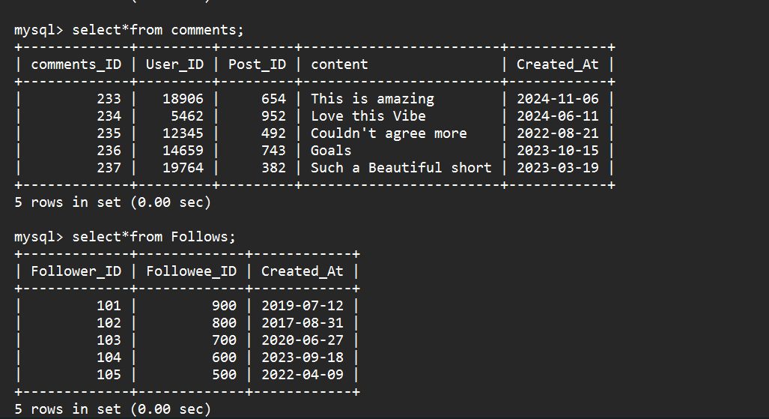

Slide 22
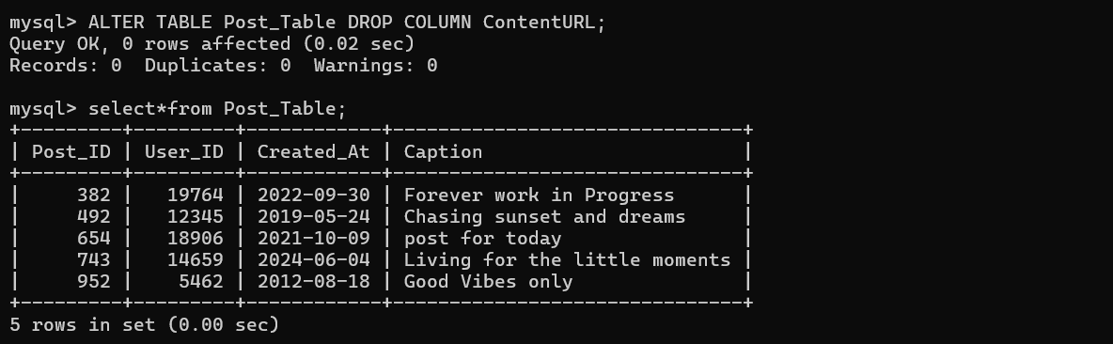
DDL Commands:
1)Create :
I'm now Following
2)Alter :
Deleting all the posts
Notes:
Deleting all the posts

Slide 23
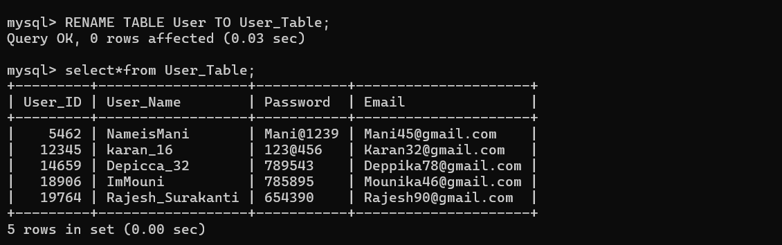
3)Rename :
Instagram just got a Make Over!
4)Drop :
Your Instagram Account has been reset
Notes:
Your Instagram Account has been reset

Slide 24
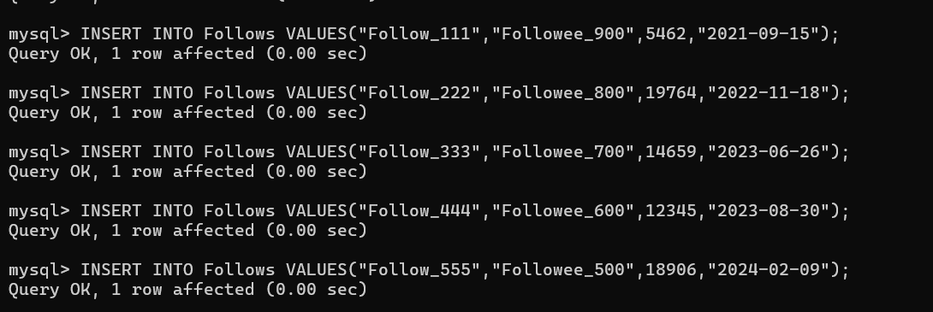
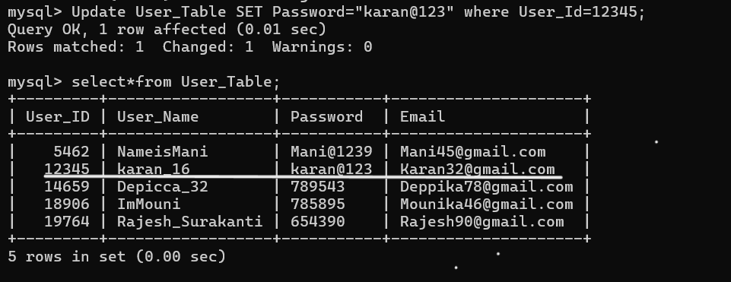
DML Commands
1) Insert
Started Networking
2) Update
Changing the password
Notes:
Started Networking
2) Update
Changing the password

Slide 25
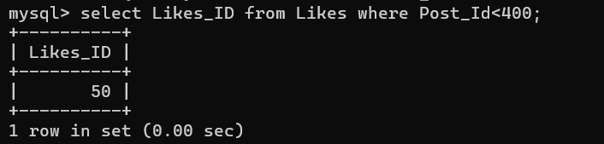
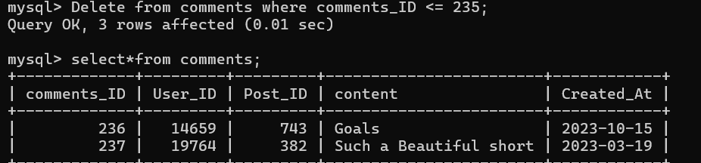
3) Select
Fetching the No of Likes for a
particular Post
4) Delete
Remove posts that
have less than
235 likes
Notes:
3) Select
Fetching the No of Likes for a particular Posta
4) Delete
Remove posts that have less than 235 likes

Slide 26
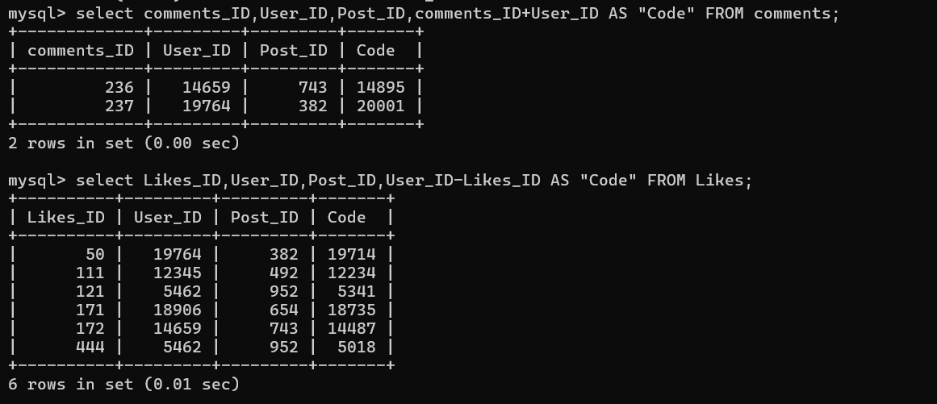
Writing unique codes for the posts using
Arithmetic Operators
1) ADDITION:
2) SUBTRACTION:
Notes:
Writing unique codes for the posts using Arithmetic Operators
1) ADDITION:
2) SUBTRACTION:

Slide 27
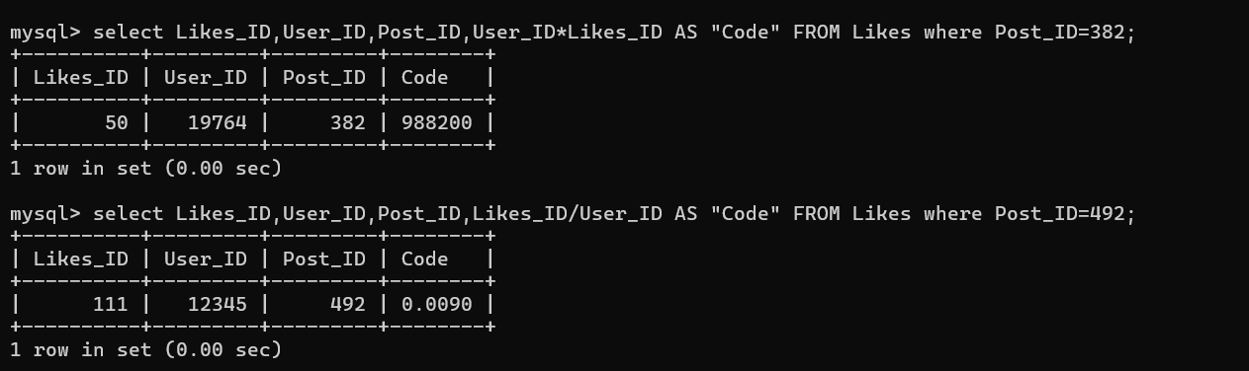
3) MULTIPLICATION:
4)DIVISION:
Notes:
3) MULTIPLICATION:
4)DIVISION:

Slide 28
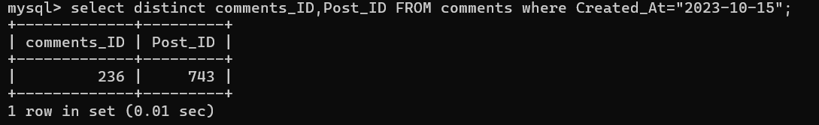
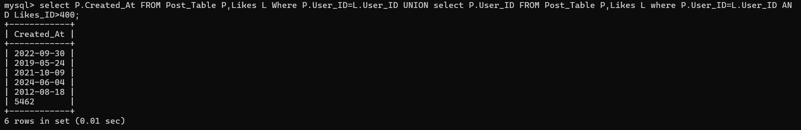
Relational Operators:
1)SELECT & PROJECT:
2)SET DIFFERENCE:
Notes:
Relational Operators:
1)SELECT & PROJECT:
2)SET DIFFERENCE:

Slide 29
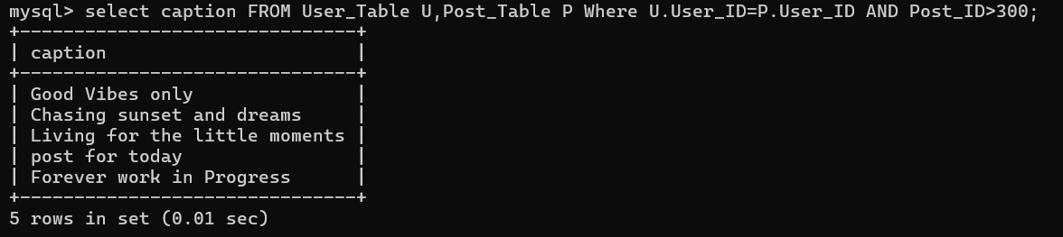
3) JOIN:
Notes:
3) JOIN:

Slide 30
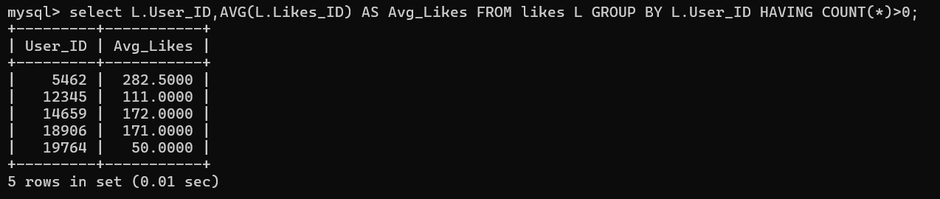
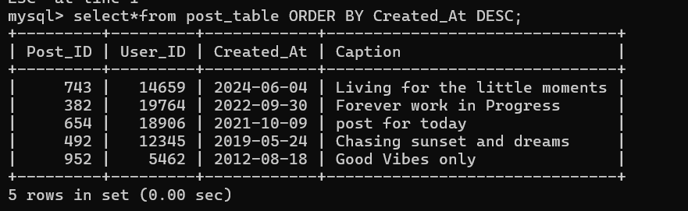
Logical Operators:
1) Group By:
2) Order By:
Notes:
Logical Operators:
1) Group By:
2) Order By:

Slide 31
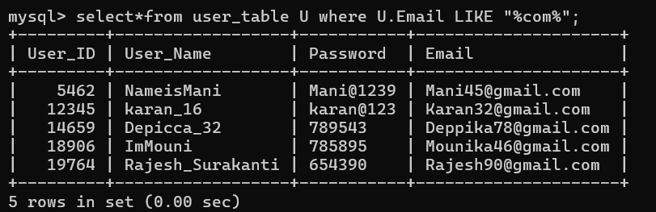
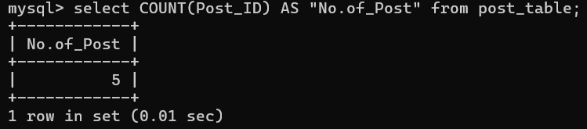
3) Like:
Aggregate Operators:
1) Count
Notes:
3) Like:
Aggregate Operators:
1) Count

Slide 32
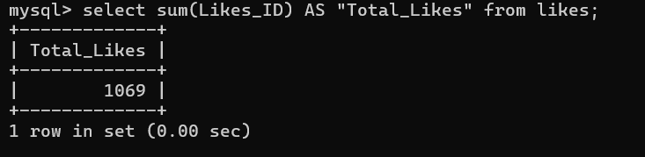
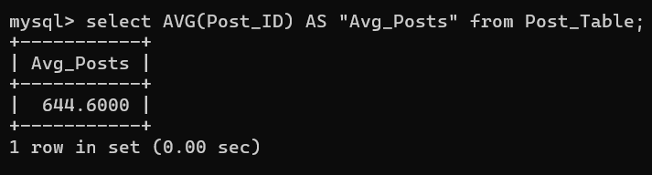
2) Sum
3) Avg
Notes:
2) Sum
3) Avg
4) Max
5) Min

Slide 33
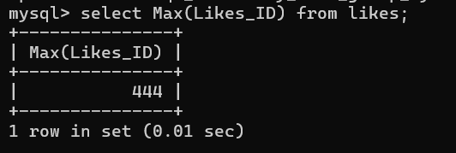
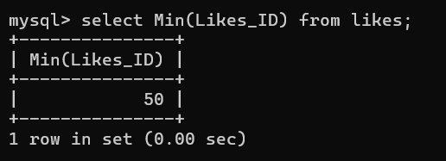
4) Max
5) Min

Slide 34
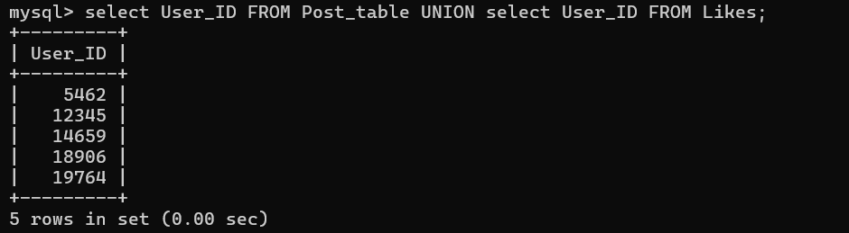
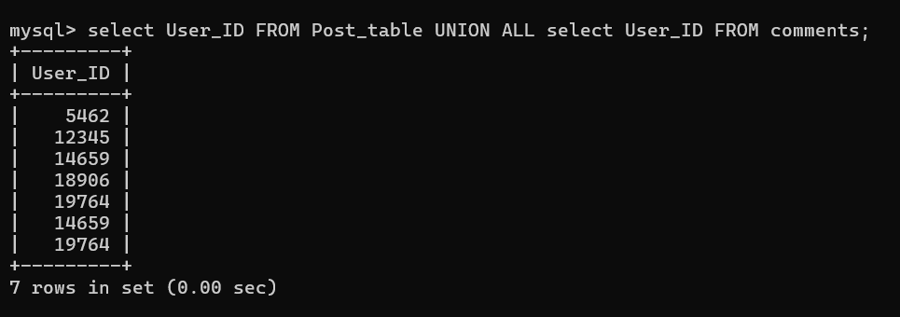
Set Operators:
1) UNION:
The UNION operator is used to combine the result-set of two or more SELECT statements.
2)UNION ALL:
The UNION operator selects only distinct values by default. To use duplicates values, use UNION ALL
Notes:
Set Operators:
1) UNION: The UNION operator is used to combine the result-set of two or more SELECT statements.
2)UNION ALL:
The UNION operator selects only distinct values by default.
To use duplicates values, use UNION ALL

Slide 35
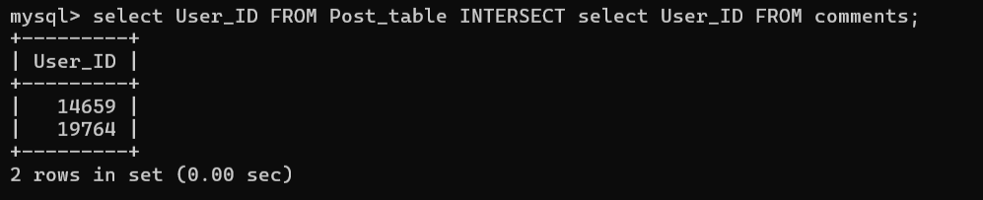
3) INTERSECT:
It returns only those rows which will be common to both of the SELECT statements.
Notes:
3) INTERSECT:
It returns only those rows which will be common to both of the SELECT statements.

Slide 36
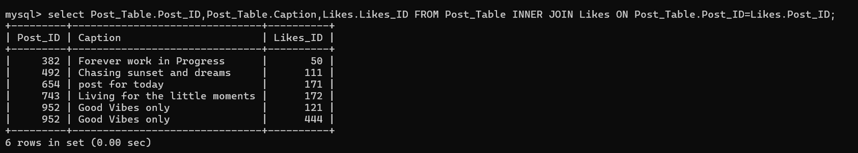
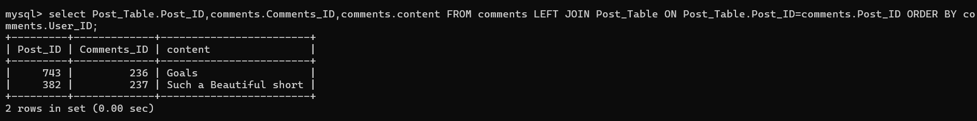
JOIN OPERATORS:
1) INNER JOIN:
The INNER JOIN keyword selects records that have matching values in both tables.
2) LEFT OUTER JOIN:
The LEFT OUTER JOIN keywords returns all records from the left table and the matching records from the right table
Notes:
JOIN OPERATORS:
1) INNER JOIN:
The INNER JOIN keyword selects records that have matching values in both tables.
2) LEFT OUTER JOIN:
The LEFT OUTER JOIN keywords returns all records from the left table and the matching records from the right table

Slide 37
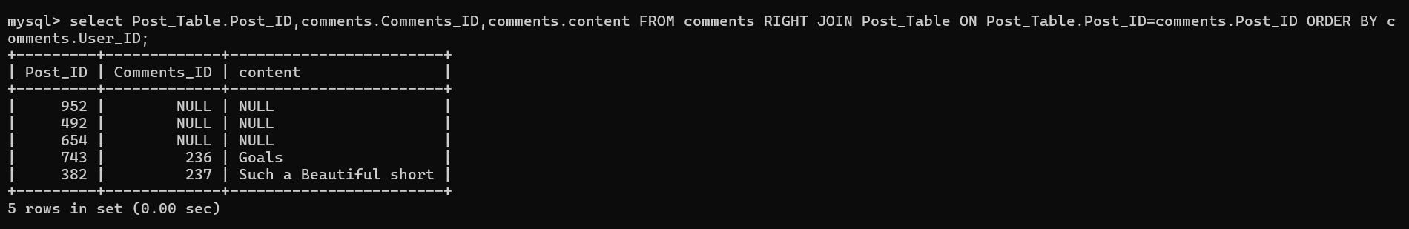
3) RIGHT OUTER JOIN:
The RIGHT OUTER JOIN keyword returns all records from the right table and the matching records from the left table
Notes:
3) RIGHT OUTER JOIN:
The RIGHT OUTER JOIN keyword returns all records from the right table and the matching records from the left table

Slide 38
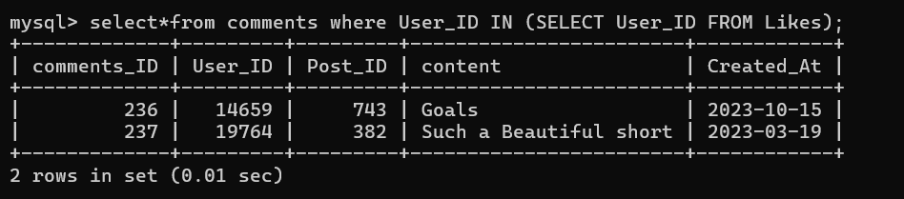
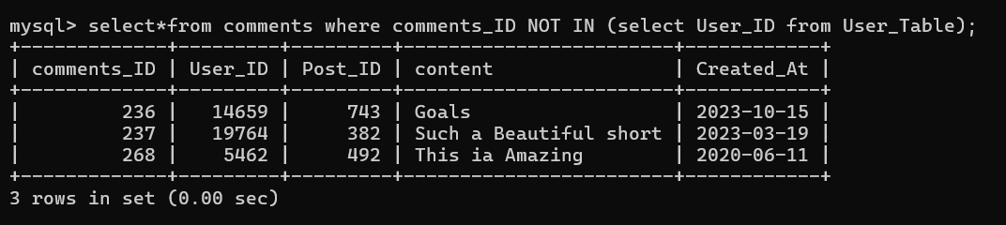
Nested Queries
1) IN:
The IN operator allows you to specify multiple values in a WHERE clause
2) NOT IN:
By using NOT keyword in front of the IN operator, you return all records that are not any of the values in the list
Notes:
Nested Queries
1) IN:
The IN operator allows you to specify multiple values in a WHERE clause
2) NOT IN:
By using NOT keyword in front of the IN operator, you return all records that are not any of the values in the list

Slide 39
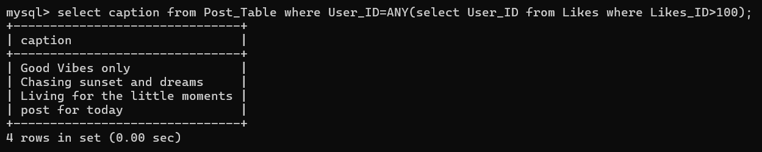
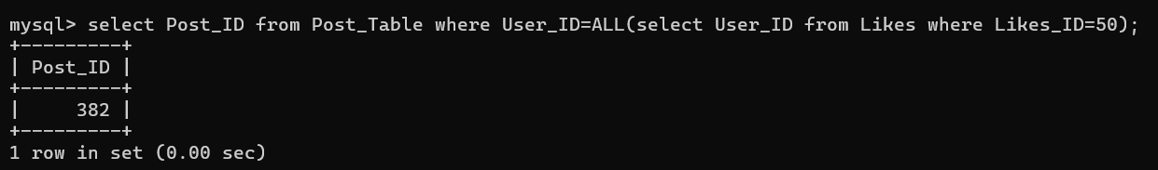
3) ANY:
ANY means that the condition will be true if he operation is true for any of the values in the range
4) ALL:
ALL means that the condition will be true only if the operation is true for all values in the range
Notes:
3) ANY:ANY means that the condition will be true if he operation is true for any of the values in the range.
4) ALL:
ALL means that the condition will be true only if the operation is true for all values in the range

Slide 40
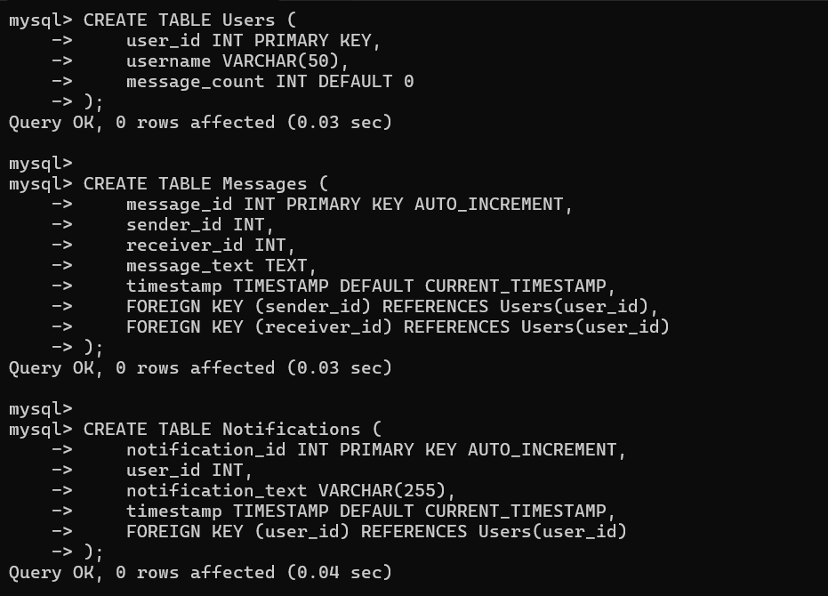
TRIGGERS :
Instagram triggers are automated actions or responses that are activated based on specific user interactions or events on Instagram.
There are four IG Triggers through which all Instagram actions can be automated:
1)Direct Message Trigger:
Automatically responding to or initiating a conversation when a user sends a direct message to the account.
Notes:
TRIGGERS :
Instagram triggers are automated actions or responses that are activated based on specific user interactions or events on Instagram.
There are 4 IG Triggers through which all Instagram actions can be automated
1)Direct Message Trigger:
Automatically responding to or initiating a conversation when a user sends a direct message to the account.

Slide 41
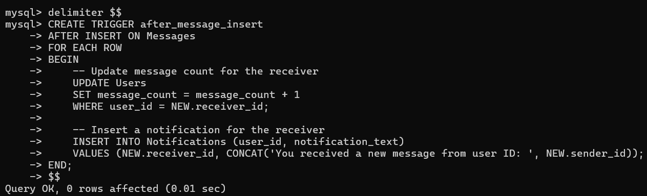
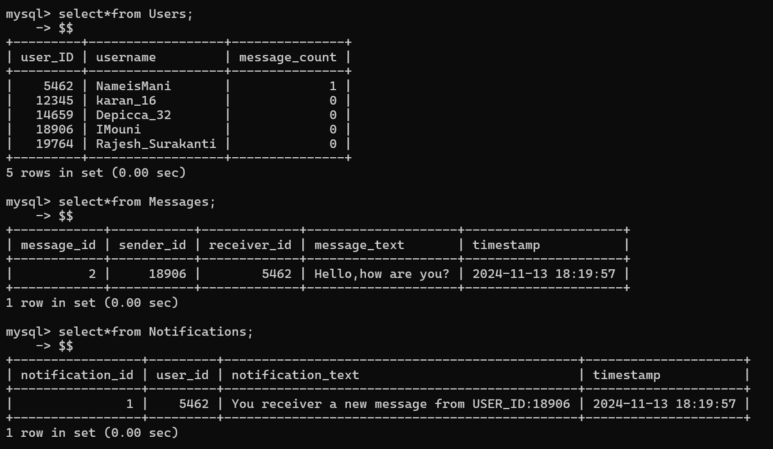
Trigger Implementation
Output
Notes:
Trigger Implementation
Output:

Slide 42
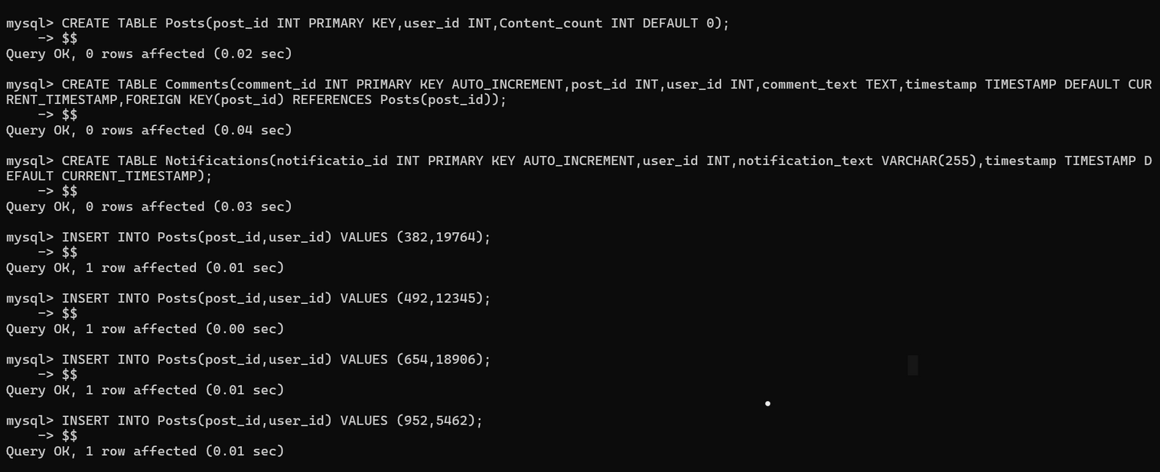
2)Comment Trigger:
Comment Triggers are automated responses(journey) activated when users comment on Instagram posts, Reels, or ads. By automating responses, marketers can ensure consistent engagement and efficient management of their social media presence.
Notes:
2)Comment Trigger:
Comment Triggers are automated responses(journey) activated when users comment on Instagram posts, Reels, or ads. By automating responses, marketers can ensure consistent engagement and efficient management of their social media presence.

Slide 43
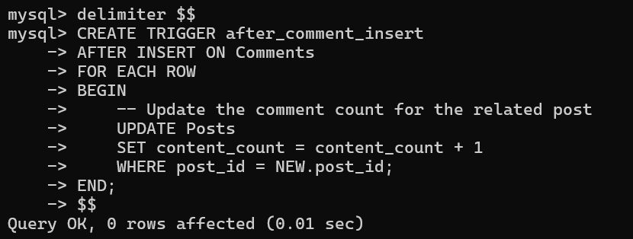
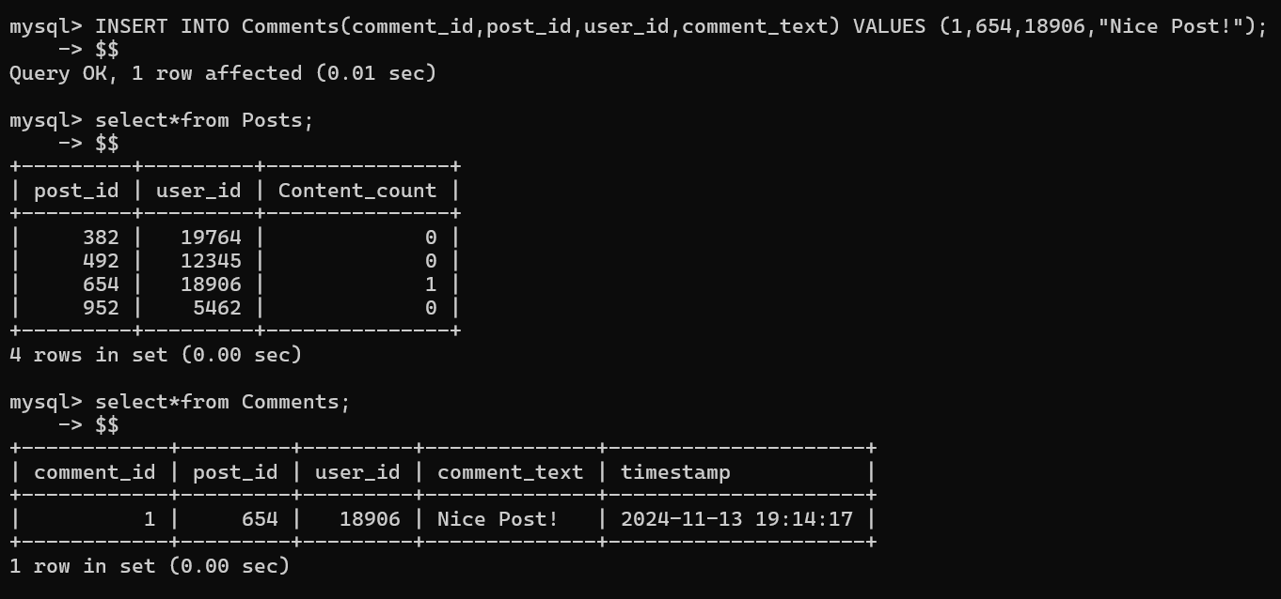
Trigger Implementation
Output
Notes:
Trigger Implementation
Output

Slide 44
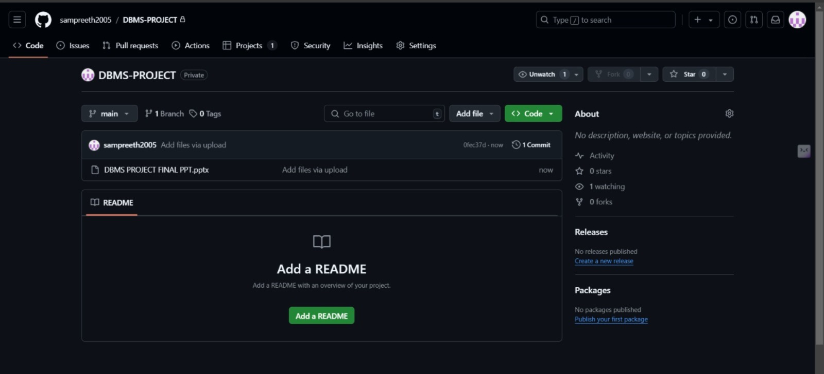
ADDING PROJECT TO GITHUB
Procedure:
Log into github account.
Create a new repository.
Click on “Upload an existing file”
Select project file from computer.
Click on “Commit”
Project file has been uploaded.

Slide 45
THANK YOU.

